Slide 1

DEE 4544 DIGITAL ELECTRONICS Chapter 2: Boolean algebra and Mapping Methods
By : Dr. Noraisyah Tajudin
Email: noraisyahtajudin@lincoln.edu.my
Faculty of Engineering
Lincoln University College (LUC)
LECTURE 2
DATE : MARCH 2024

Slide 2
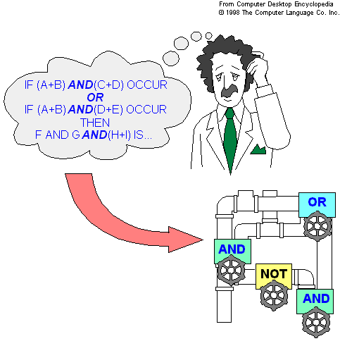
What is Boolean Algebra?
Boolean Algebra is used to analyze and simplify the digital logic.
Importance
Boolean Algebra simplify the Boolean expressions; that led to simpler the circuits which reduces cost, area requirement and power consumption.
Example:
AB+AB+AC+BB+AC
.
.
.
Applying Boolean rules
B+AC

Slide 3
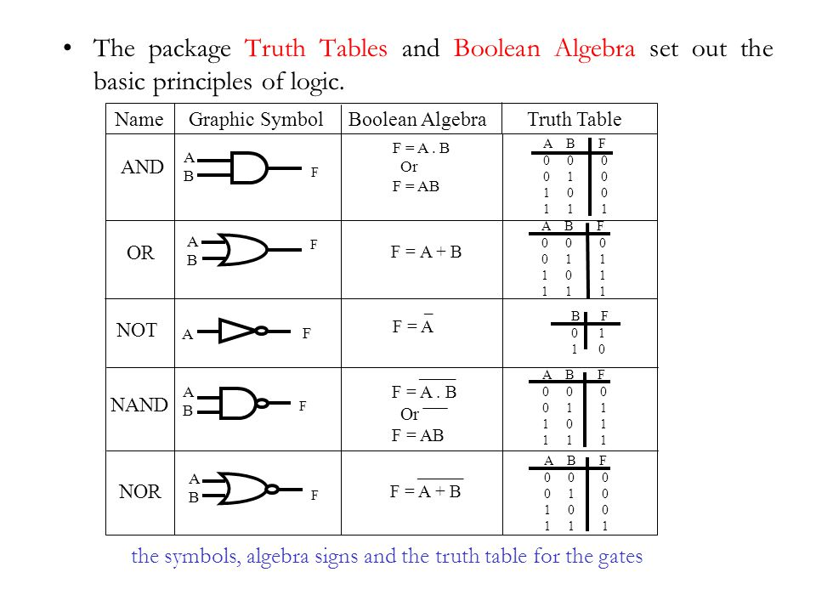

Slide 4
Literals:
Literal is a variable or its complement.
For Example:
+B+C
It has three literals…
Addition:
Addition is equivalent to the OR operation
Each literal must be equal to zero
Example:
Determine the values that make the sum term of expressions +B +
Each literal must be equal to 0; therefore
A=1, B=0, C=1
Multiplication:
Multiplication is equivalent to AND operation
Each literal must be equal to 1
Example
Value of AB&C if the product term is A+ +C
A=1, B=0, C=1

Slide 5
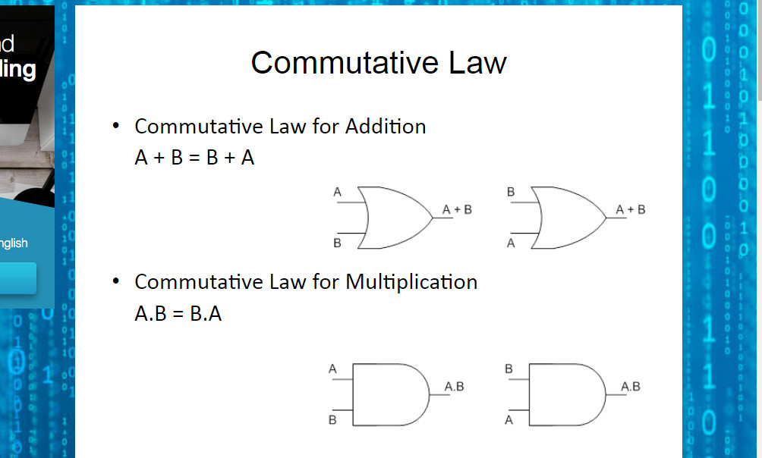
Boolean Algebra Rules & Laws

Slide 6
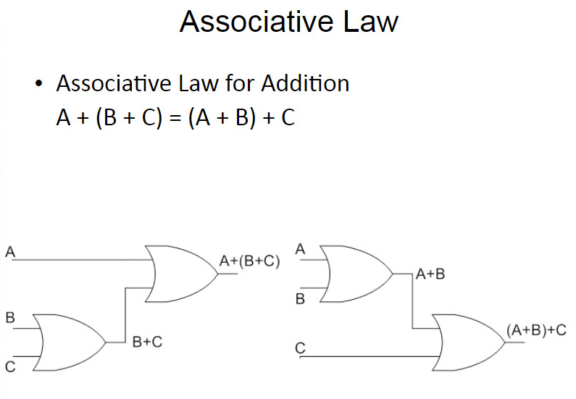

Slide 7
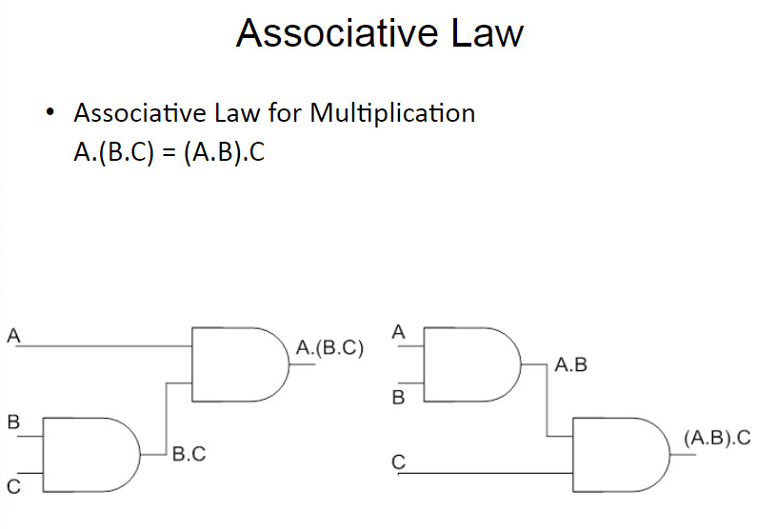

Slide 8
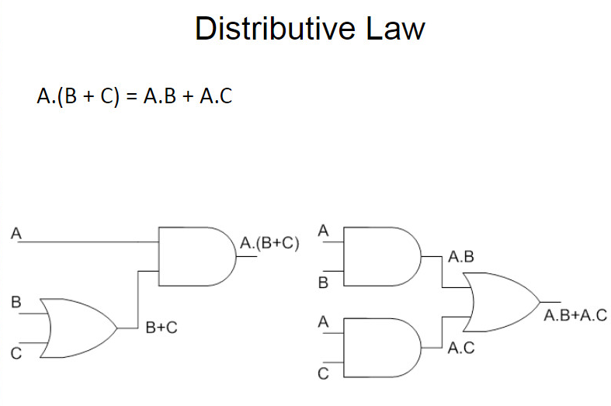

Slide 9
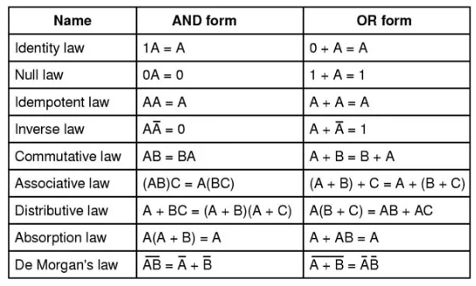
Rules of Boolean Algebra

Slide 10
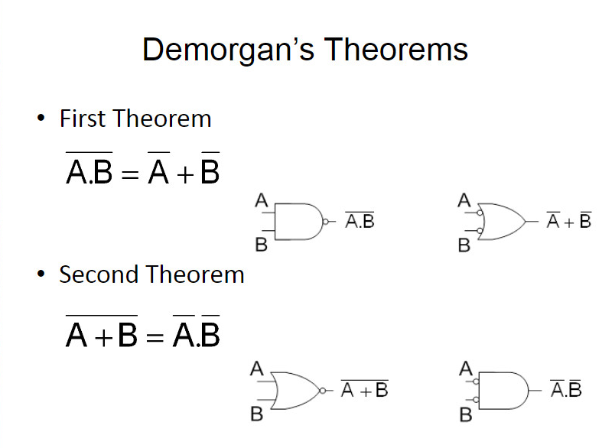

Slide 11
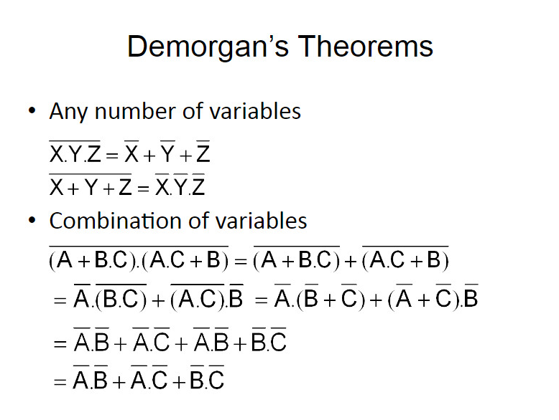

Slide 12
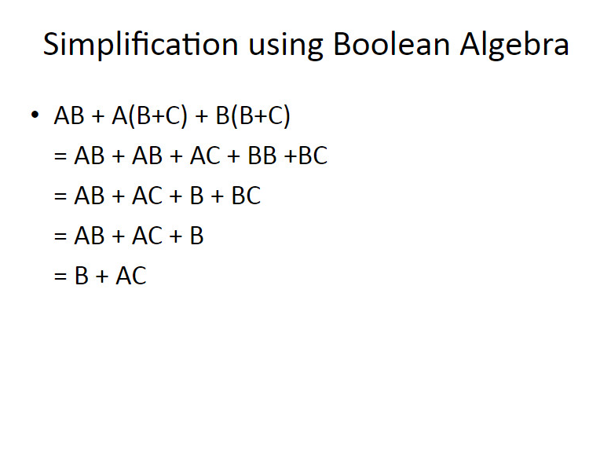
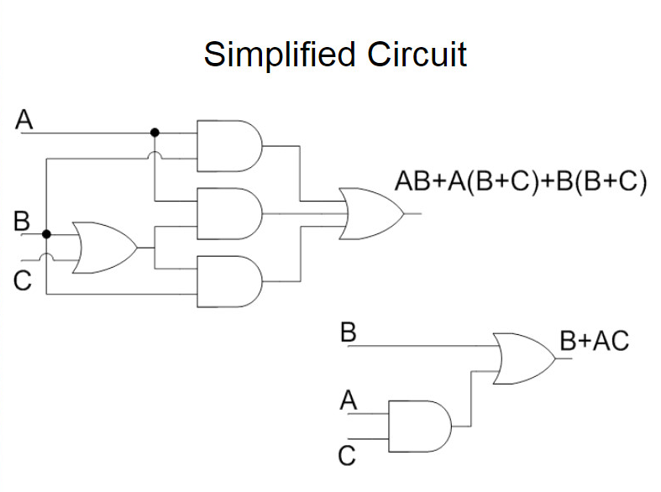

Slide 13
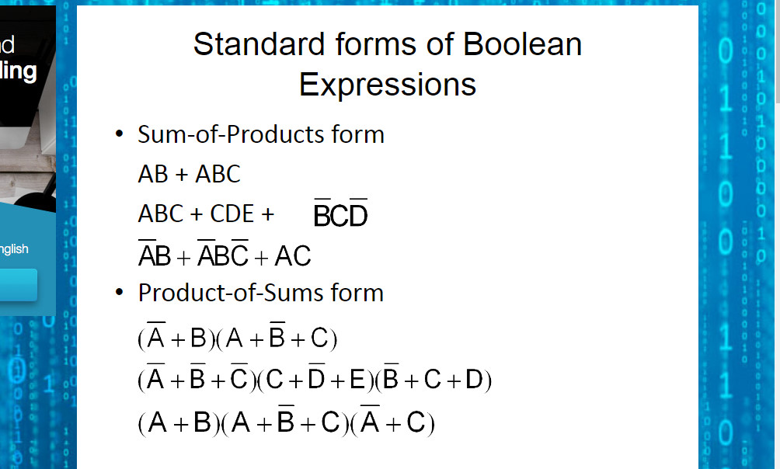
Boolean expressions can be written in the sum-of-products form (SOP) or in the product-of-sums form (POS).

Slide 14
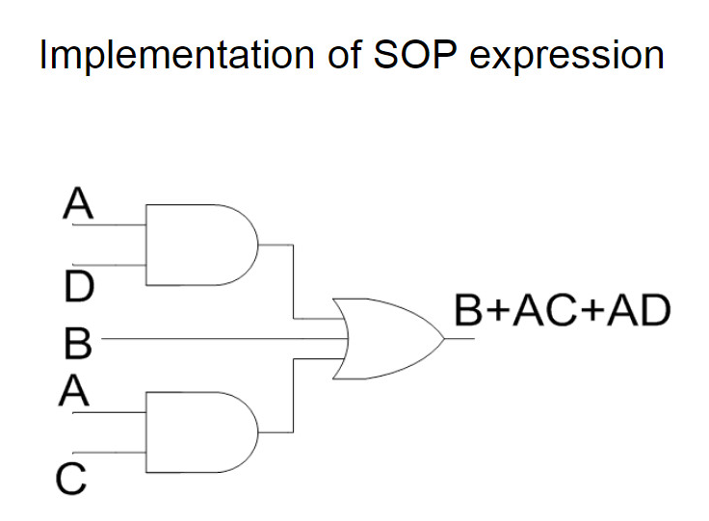

Slide 15
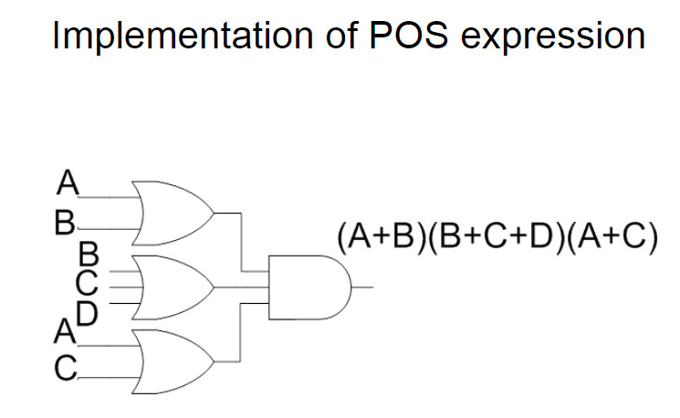

Slide 16
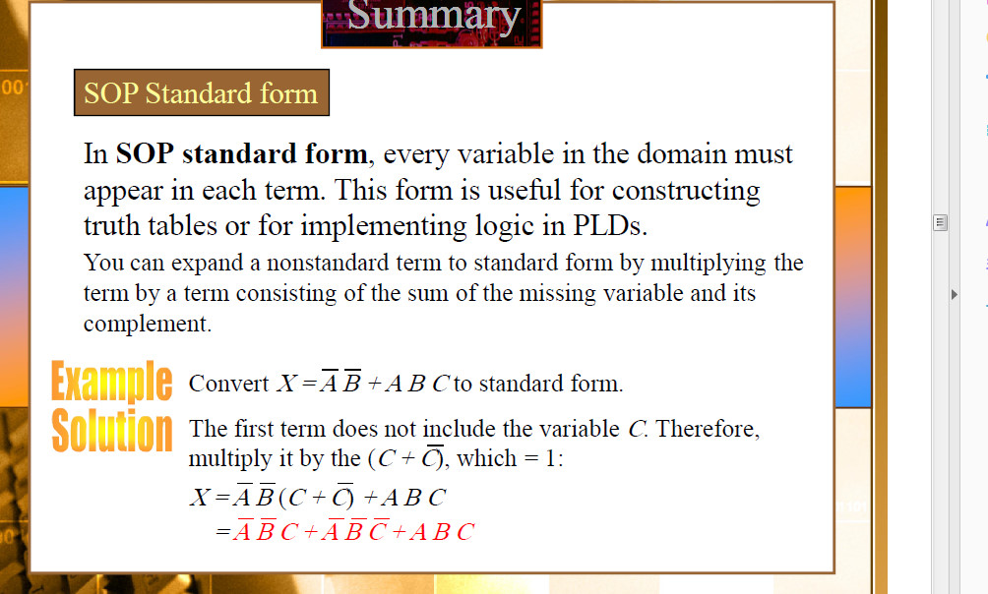
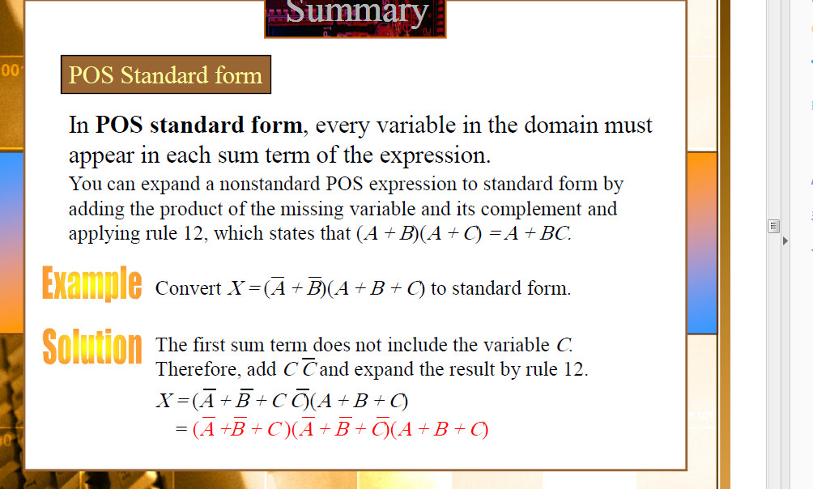

Slide 17
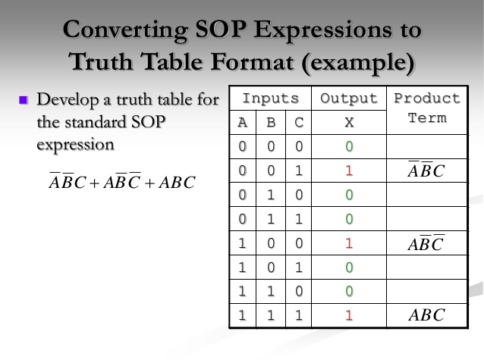
POS

Slide 18
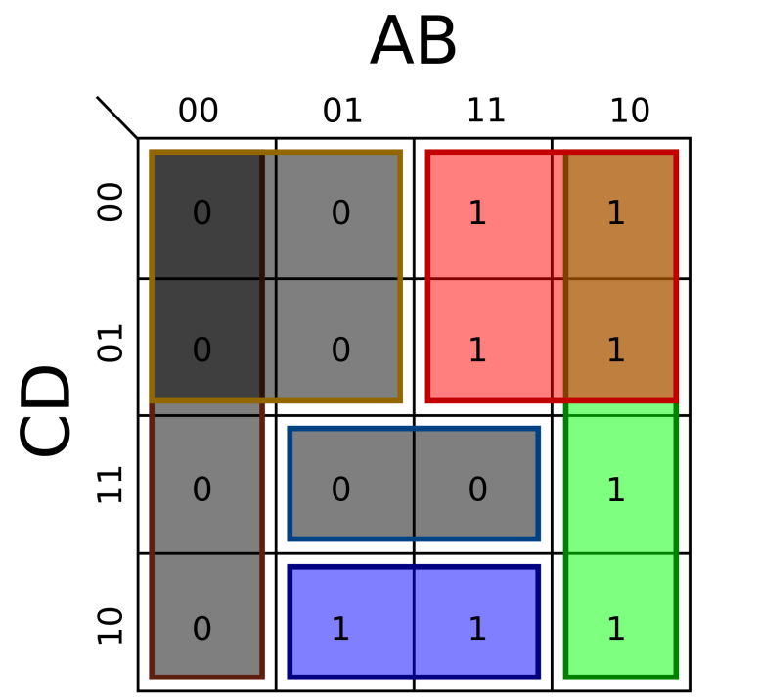
K-Map
K-Map is a tool for simplifying the combinational logic of variables.
Number of cells are required according to the number of variable in 2^{n} form.
Where n is number of variable.
Cells are usually labeled using 0’s and 1’s to represent the variable and its complement.
The numbers are entered in gray code, to force adjacent cells to be different by only one variable.

Slide 19

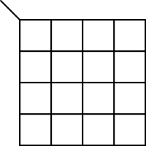
K-Map Table Format
3-Variable Table
2-Variable Table
4-Variable Table

Slide 20
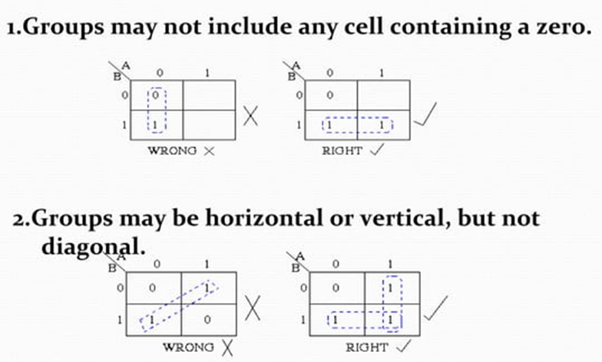
K-MAP – RULES OF SIMPLIFICATION
The K-map uses the following rules for the simplification of expressions by grouping together adjacent cells containing ones

Slide 21
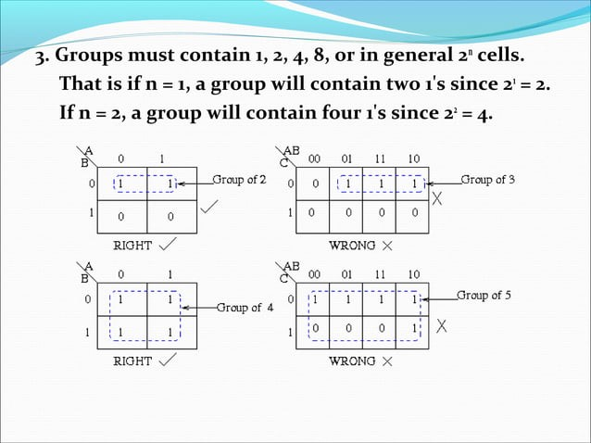
K-MAP – RULES OF SIMPLIFICATION

Slide 22
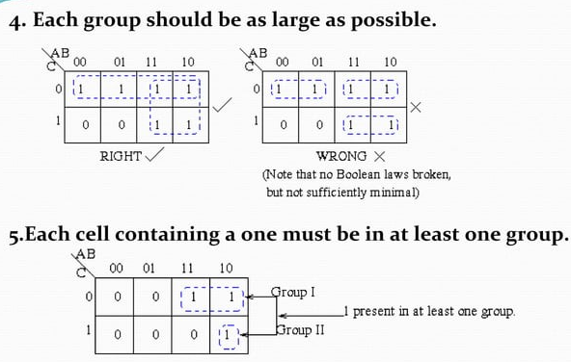
K-MAP – RULES OF SIMPLIFICATION

Slide 23
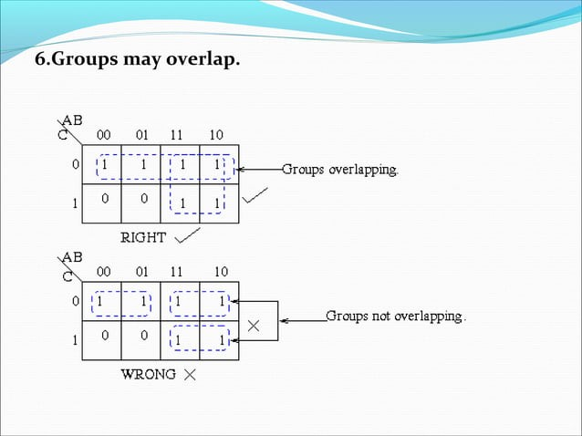

Slide 24
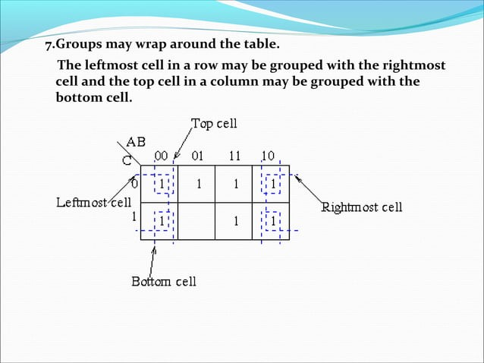

Slide 25
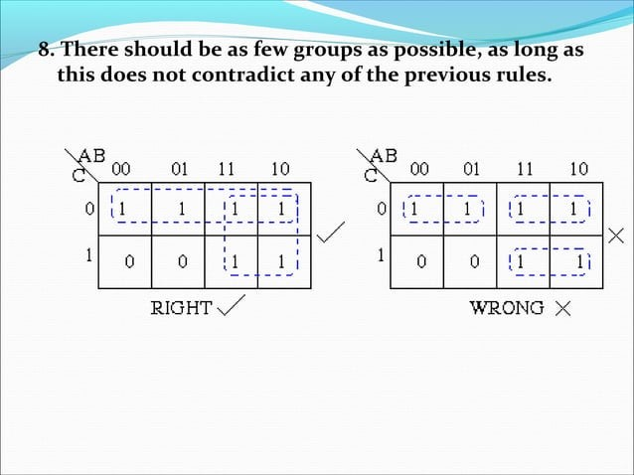

Slide 26
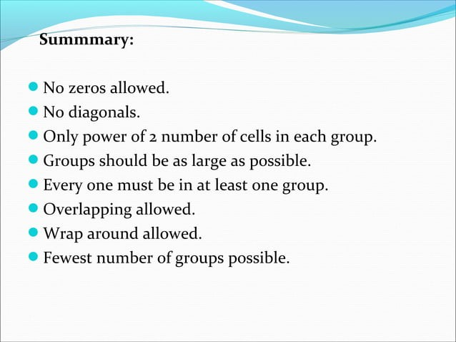

Slide 27
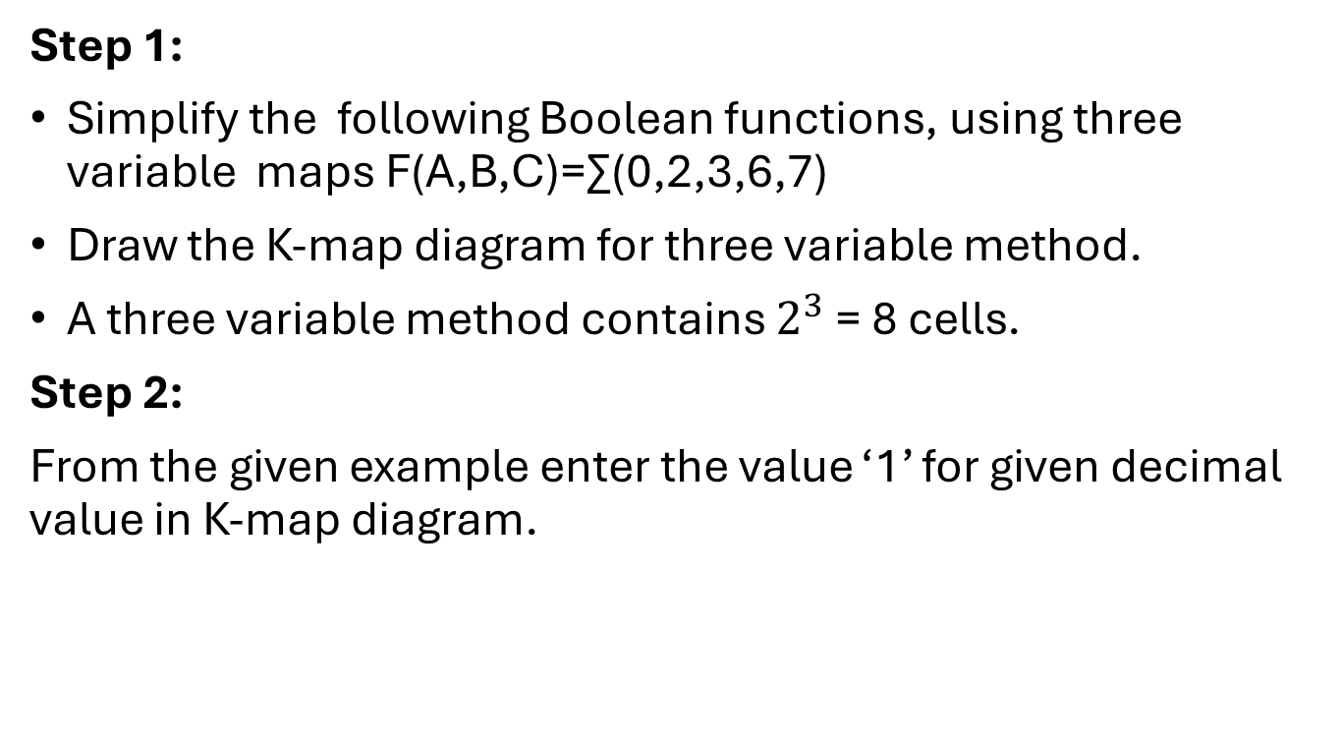
THREE VARIABLE KARNAUGH MAP
Step 1:
Simplify the following Boolean functions, using three variable maps F(A,B,C)=∑(0,2,3,6,7)
Draw the K-map diagram for three variable method.
A three variable method contains $2^{3}$ = 8 cells.
Step 2:
From the given example enter the value ‘1’ for given decimal value in K-map diagram.
AB C | 00 | 01 | 11 | 10
0 | 1 | 0 | 1 | 1
1 | 0 | 0 | 1 | 1

Slide 28
THREE VARIABLE KARNAUGH MAP
Step 3:
Check for those 1’s which are adjacent to only one other 1 and encircle such pairs.
AB C | 00 | 01 | 11 | 10
0 | 1 | 0 | 1 | 1
1 | 0 | 0 | 1 | 1

Slide 29
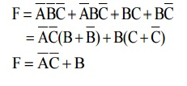
THREE VARIABLE KARNAUGH MAP
Step 4:
Simplify the boolean expression from step 3.

Slide 30
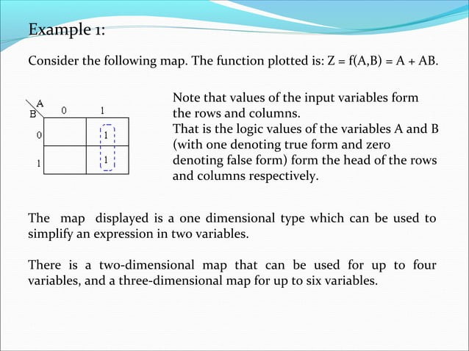

Slide 31
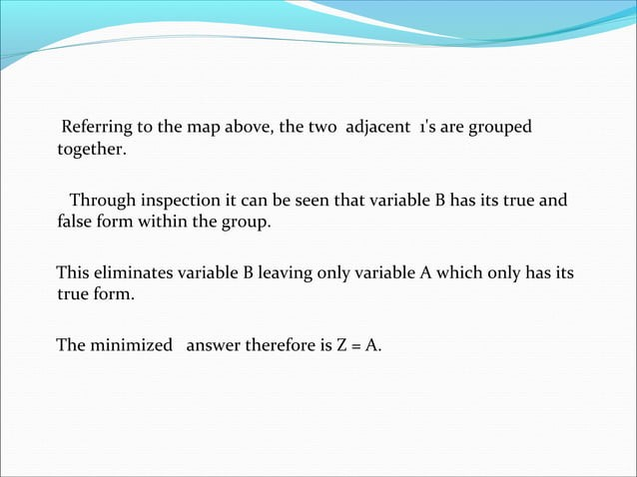

Slide 32
Example 2:Sketch the K-Map and find the functions of the K-Map.
A | B | C | F
0 | 0 | 0 | 0
0 | 0 | 1 | 0
0 | 1 | 0 | 1
0 | 1 | 1 | 0
1 | 0 | 0 | 1
1 | 0 | 1 | 1
1 | 1 | 0 | 1
1 | 1 | 1 | 0

Slide 33
Example 2: Sketch the K-Map and find the functions of the K-Map.
A | B | C | F
0 | 0 | 0 | 0
0 | 0 | 1 | 0
0 | 1 | 0 | 1
0 | 1 | 1 | 0
1 | 0 | 0 | 1
1 | 0 | 1 | 1
1 | 1 | 0 | 1
1 | 1 | 1 | 0
AB C | 00 | 01 | 11 | 10
0 | 0 | 1 | 1 | 1
1 | 0 | 1 | 0 | 1
F = BC’ + AB’ + A’BC

Slide 34
Exercise: Sketch the K-Map for the given function
1) F = AC + AB’
2) F = AB’ +AC + A’BC’
3) F = AB’ + A’CD + ABC’

Slide 35
Thank You

